Slide 1
TOPIC:- The Psychology of Conspiracy Theory: Why People Believe Them
ITM B-SCHOOL KHARGHAR
BY MUBEEN
HAVEESH
PARAMJEET
ANUBHAV
PULKIT

Slide 2
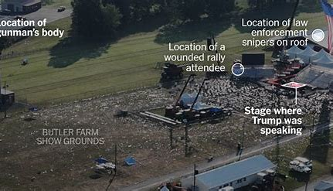
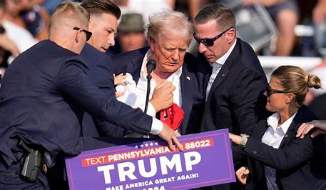
INTRODUCTION
18TH JULY 2024

Slide 3
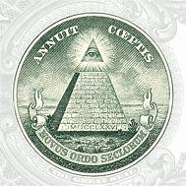
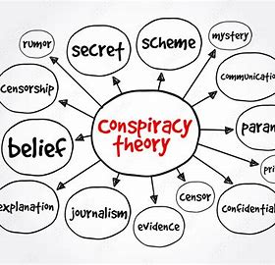
DEFINITION AND TYPES
A conspiracy theory is a belief that a group of people are secretly trying to harm someone or achieve something.
Political Conspiracies
Medical Conspiracies
Extraterrestrial Conspiracies

Slide 4
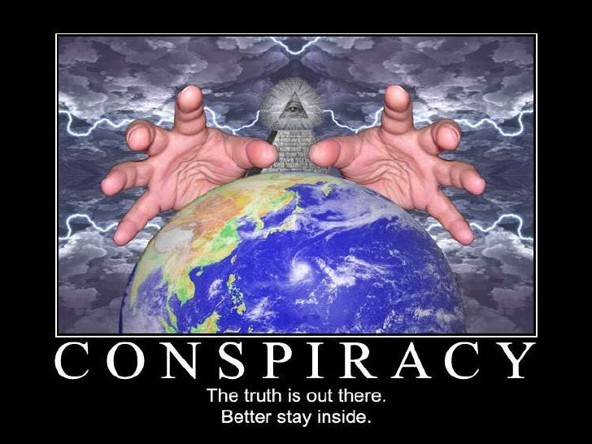

Slide 5
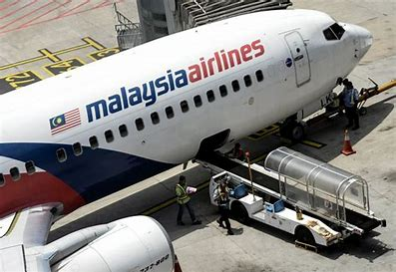
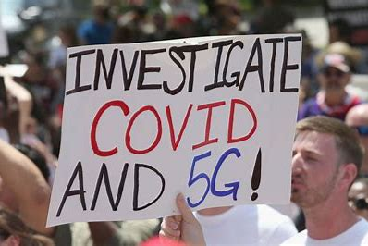
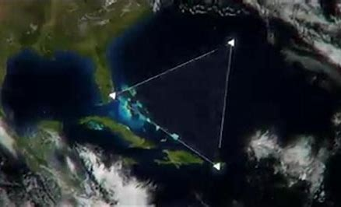
EXAMPLES OF CONSPIRACY THEORIES

Slide 6

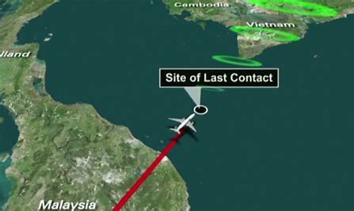
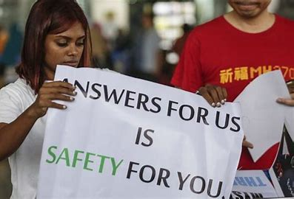
MALAYSIA AIRLINES FLIGHT 370
SAFETY
QUESTIONS OF LIVES
TRUST OF PASSENGER

Slide 7

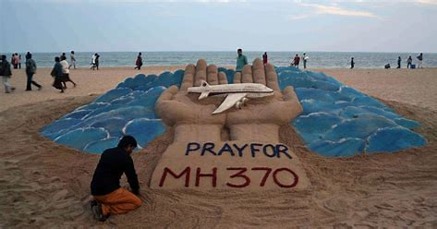
WHERE DID IT GO???????

Slide 8

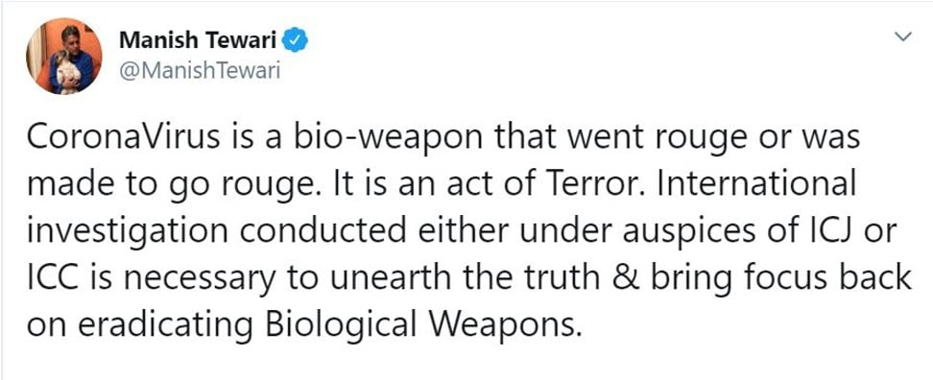
COVID-19 CONSPIRACY
WAS IT PLANNED?

Slide 9
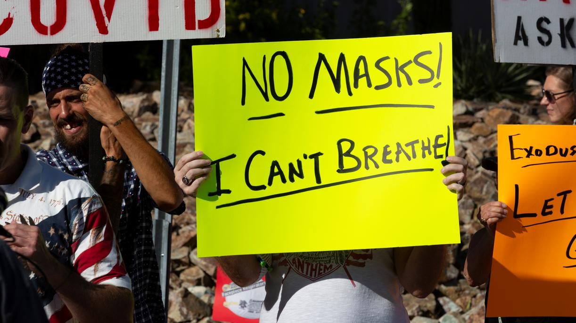

You don’t need to wear a mask
Vaccine will be unsafe

Slide 10

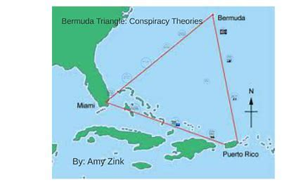
BERMUDA TRIANGLE
The Bermuda Triangle Enigma: Uncovering the Actual Secrets Behind Disappearing Vessels.

Slide 11

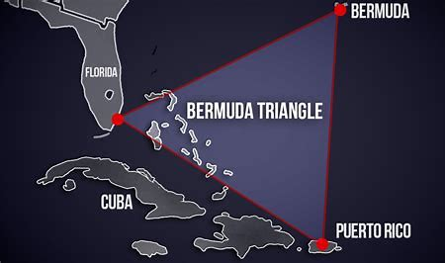
Rogue Waves
Magnetic Forces
Alien Activity
DEVILS TRIANGLE

Slide 12
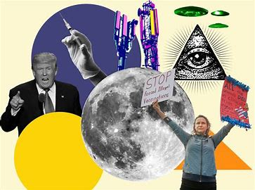

WHY DO PEOPLE BELIEVE IN CONSPIRACY THEORIES?

